Slide 1

Automated
Certificate
System

Slide 2
Usage Guidelines
The Automated Certificate System should be used on a laptop or desktop computers ONLY.
Using smaller screens hinders the admin to set the sample name placement correctly.

Slide 3
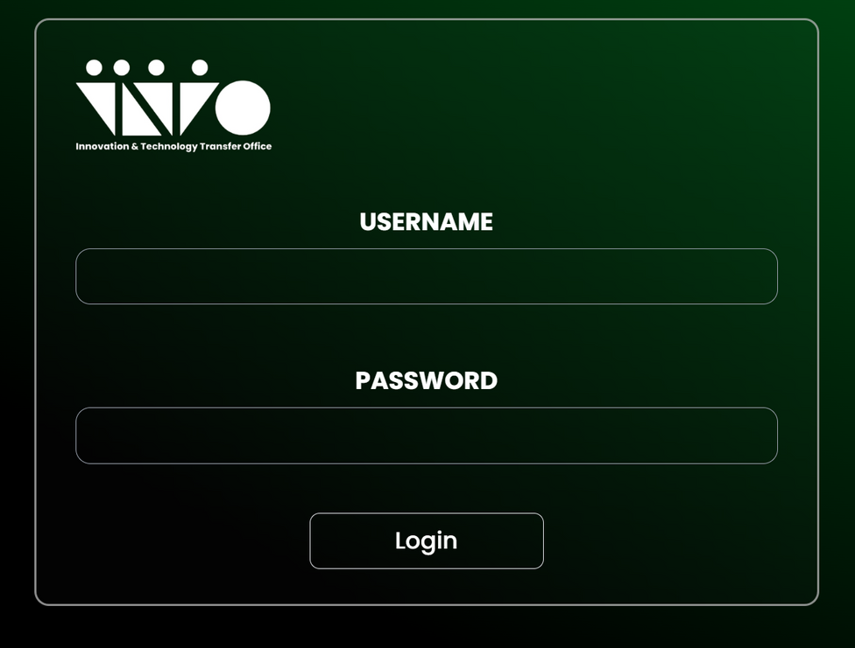
Login
Enter your admin credentials (email and password).
Click Login to access the dashboard.

Slide 4
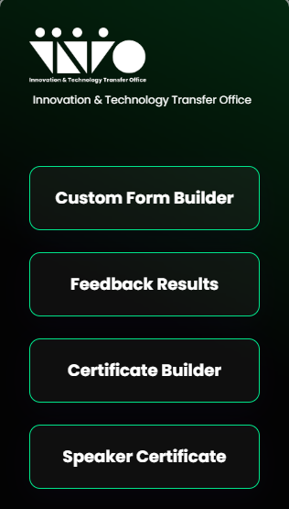
Dashboard
After logging in, you will be taken to the main admin interface, which includes:
A sidebar menu with the following options:
Custom Form Builder
Feedback Results
Certificate Builder

Slide 5
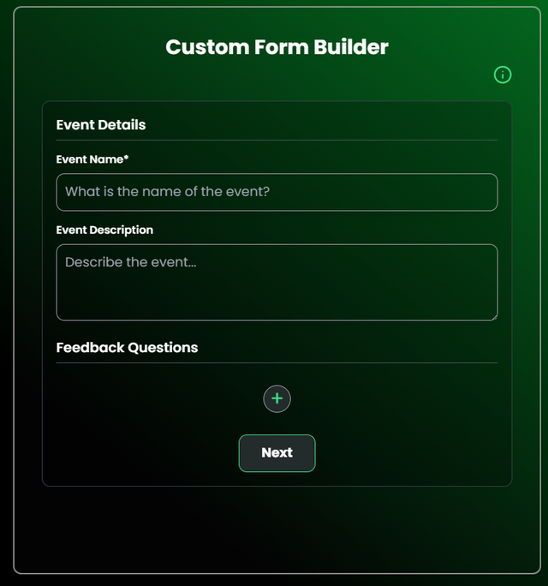
Custom Form Builder
Custom Form Builder in the sidebar shows the following inputs:
Event Name
Event Description
Feedback Questions (press the + button to add)
You can add a variation of questions:
Text (for open ended questions)
Rating (1 to 5)
Long Text (for longer answers, similar to text)
College/Department (if requiring the department affiliation of the participant)
Likelihood scale (unlikely to likely)

Slide 6
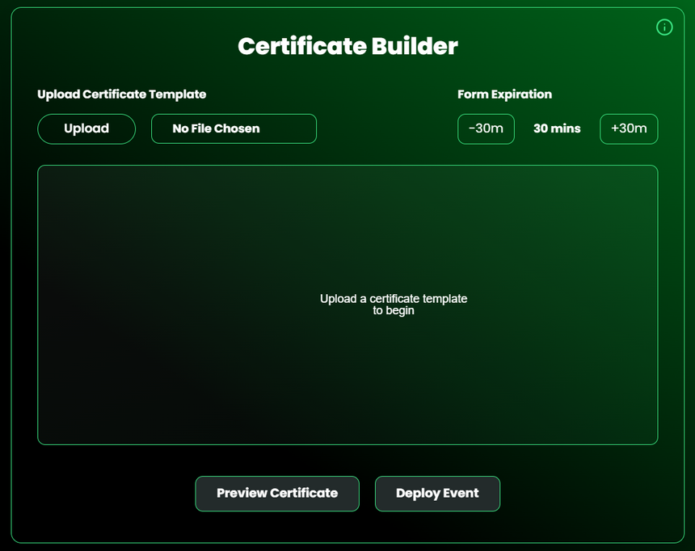
Certificate Builder
Certificate Builder in the sidebar or after filling up the form builder shows the following inputs:
Upload
Allows the admin to upload a certificate template.
Form expiration
This is to set the duration for the feedback form link(default and lowest duration is 30mins). the admin can add the duration in 30mins increments.
Sample Name
An element to allow the admin to set the location of the names of the certificate output. It can be clicked and dragged, and scrollable to set the font size for the names.
Preview Certificate
It is used to verify the actual position output of names when a certificate is generated.
Deploy Event
When all things needed are set, this is to deploy the feedback form , the duration set, and the certificate uploaded.

Slide 7
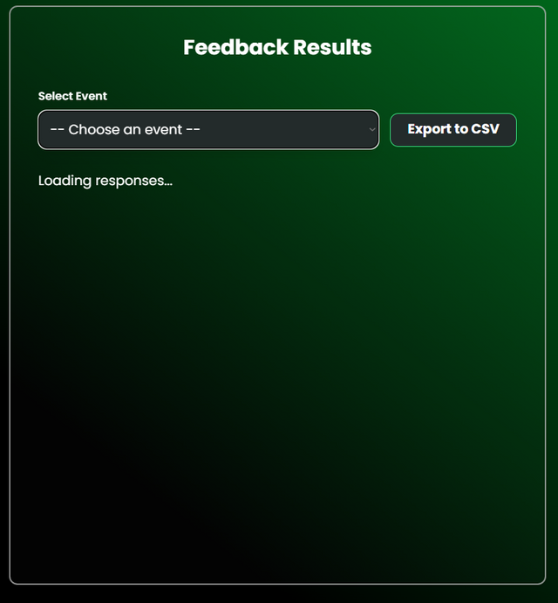
Feedback Results
Feedback Results in the sidebar shows the following inputs:
Choose an event
After choosing an event, questions inputted, including the responses are shown.
Export to CSV
When clicked, it would automatically download feedback results in a .csv file

Slide 8
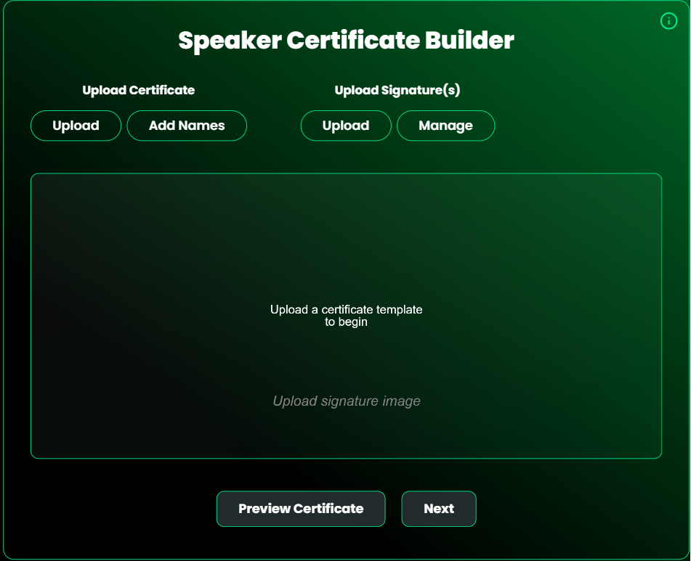
Speaker Certificate
Speaker Certificate in the sidebar shows the following inputs:
Upload Certificates
Allows the admin to upload certificates
Add Names
Allows the admin to add multiple names to sign the certificates
Add Signatures
Allows the admin to upload signatures
Manage Signatures
Allows the admin to add or remove signatures.

Slide 9
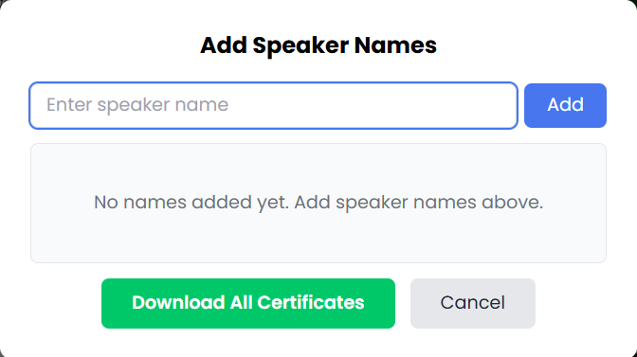
Speaker Certificate
After clicking next:
Allows the admin to add the names of the speaker/s
Download all certificates button
When clicked, downloads all certificates of the respective names listed simultaneously

